Slide 1
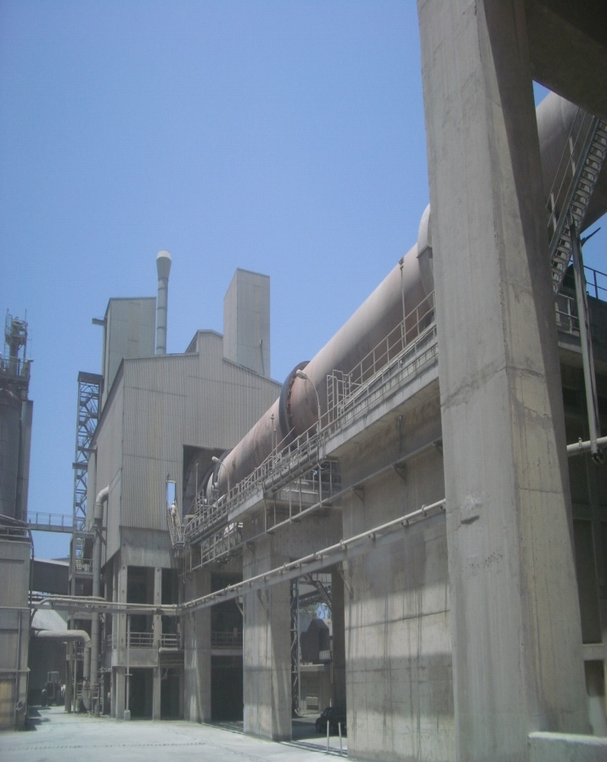
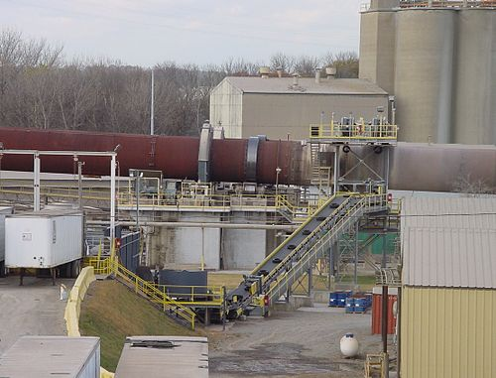
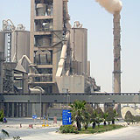
BY-PASS SYSTEM
IN CEMENT INDUSTRY

Slide 2
REASON FOR USING A BY-PASS SYSTEM IN CEMENT INDUSTRY
Using a high amount of secondary fuel and raw meal which are having often higher content of chlorine, alkalis and sulphur
Against build ups and heavy coating in the area of the kiln riser duct and meal pipe to the kiln

Slide 3
MAIN ADVANTAGE OF CHLORINE BY-PASS SYSTEM
Controlled clinker production
Continuous kiln operation
High degree of flexibility
Low amount of By - Pass dust
High chlorine, sulphur and alkali concentration in By – Pass dust

Slide 4
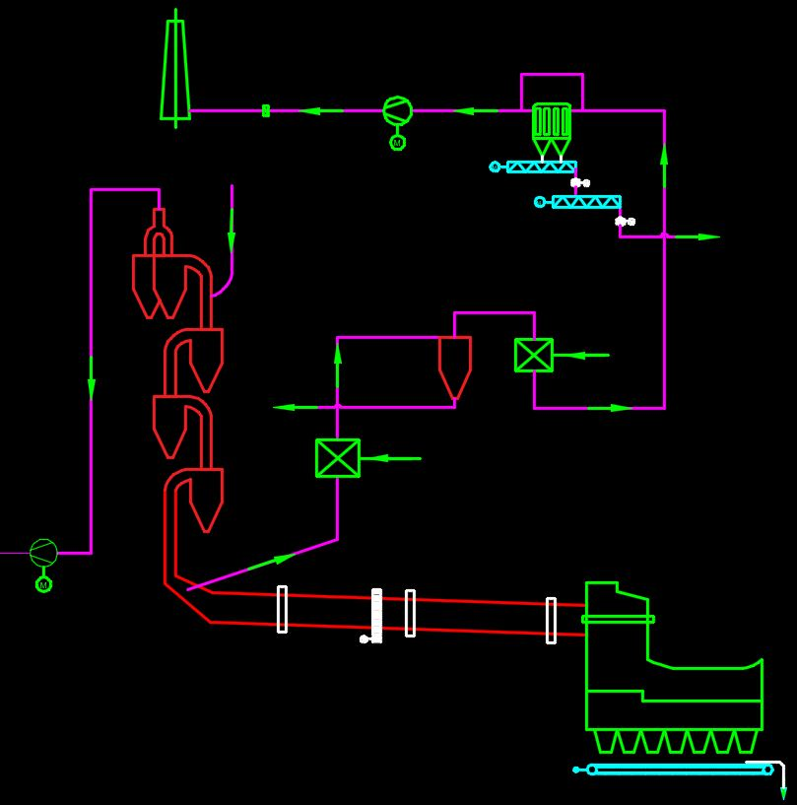
STANDARD CHLORINE BY-PASS SYSTEM

Slide 5
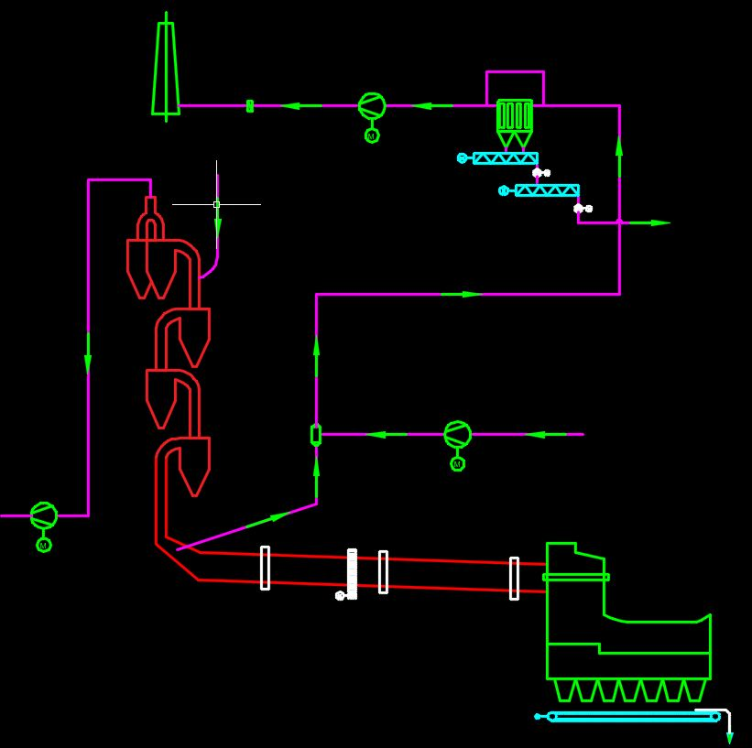
BQB CLOROSORB ™

Slide 6
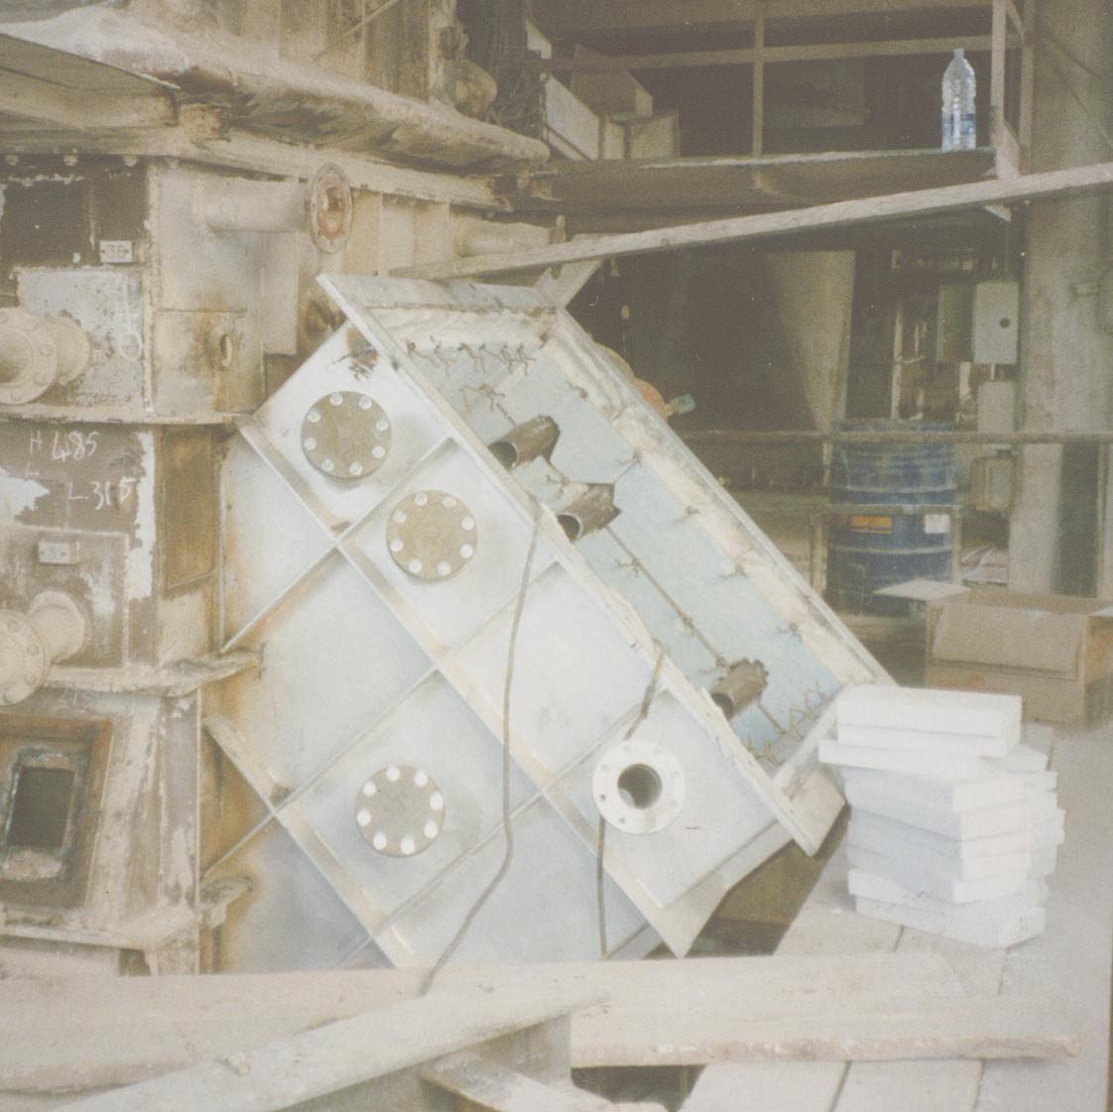
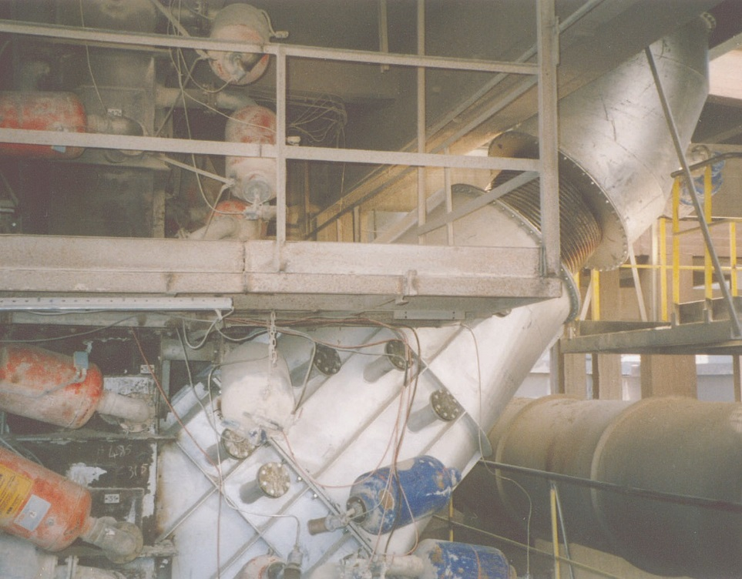
GAS TAKE OFF DUCT
Main Advantages:-
Big take off area
Low velocity
Particles < 10µm
No cyclones needed
Gas can be used for raw meal drying to reduce thermal losses

Slide 7
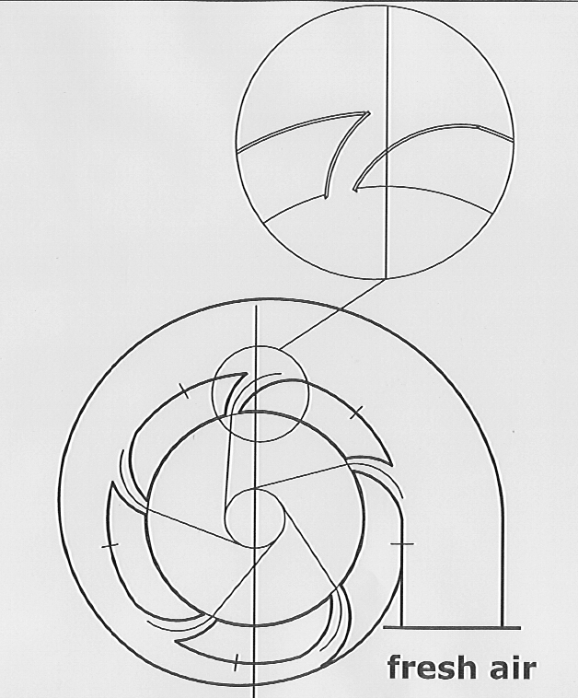
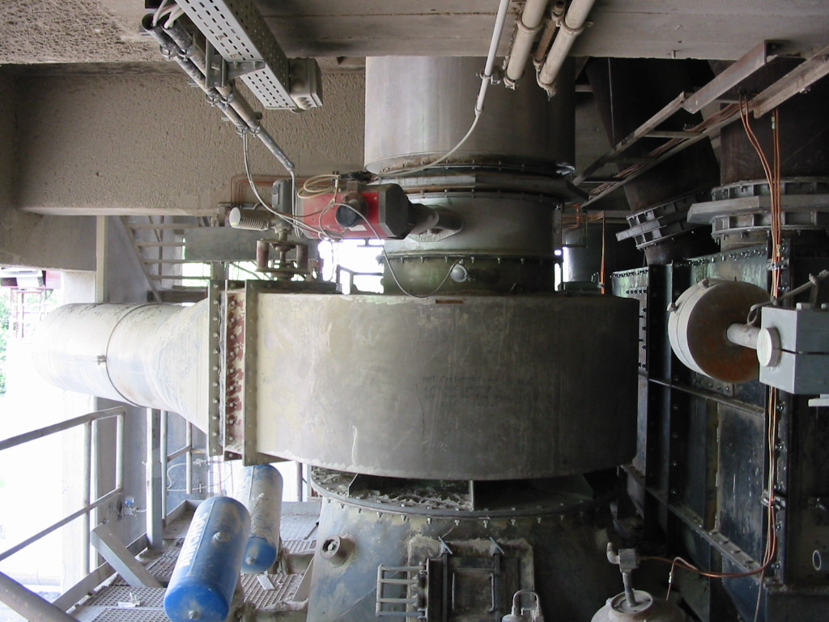
QUENCHING CHAMBER
Made completly from metal
Cooling in one step to 200°C
Minimum space requirement
Simple functionality

Slide 8
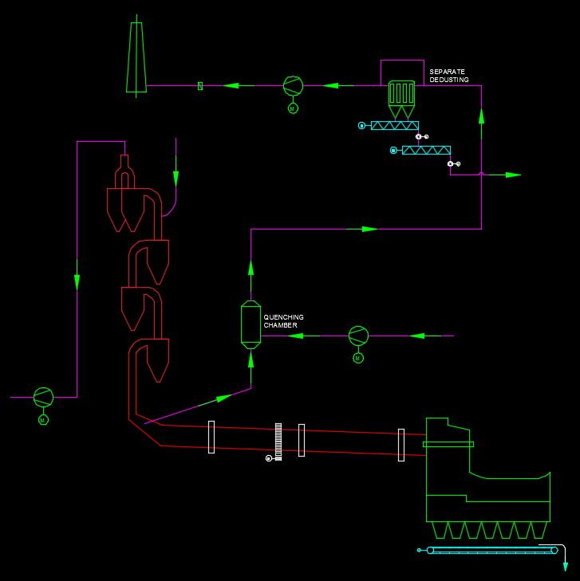
BY-PASS SEPARATE DEDUSTING SYSTEM
High Flexibility
High Efficiency
Lower Energy Consumption

Slide 9
The Companies We have Worked with
Green Island Cement

Slide 10
References
PLANT MODIFICATION/ENGINEERING/SUPPLY
Sl. No. | PLANT | COMPANY | COUNTRY | YEAR | PROJECTS | Remarks
1. | Lafarge Egypt | Lafarge Holcim | Egypt | 2014 | Engineering, Design and Supply of Cement Cooler to bring down the temperature of oil well cement from 130 degC to 70 degC. Scope also includes the design & supply of cement silo and bulk loading system | Project in completion stage
2. | Birla White | Ultratech Cement Limited | INDIA | 2014 | Supply of 2 units (1 left turning & 1 right turning) of Spare Guide Vanes (Dia. 1060 mm).
3. | Satna Cement Works | Birla Corporation India Pvt. Ltd. | INDIA | 2012 | Supply of Guide Vanes (Dia. 3900mm) for stage 3 and modification of Cyclones and Pre-Calciner for production increase. | Reduction in pressure drop achieved in result by ≥50% .
4. | Arghakhanchi Cement |  | Nepal | 2012 | Design, Engineering and Supply of Kiln Shell and Special Design of Kiln Chairpads. | Supply and Erection

Slide 11
References
PLANT MODIFICATION/ENGINEERING/SUPPLY
Sl. No. | PLANT | COMPANY | COUNTRY | YEAR | PROJECTS | Remarks
5. | Satna Cement Works | Birla Corporation India Pvt. Ltd. | INDIA | 2010 | Design and modification of Preheater 3rd Stage Cyclone. Production increased by 150 TPD. | Implemented and running well
6. | Satna Cement Works | Birla Corporation India Pvt. Ltd. | INDIA | 2010 | Detailed engineering and manufacturing drawing supply for New Coal Mill VRM. | Implemented and running well
7. | Satna Cement Works | Birla Corporation India Pvt. Ltd. | INDIA | 2010 | Cyclone design for preheater stage 3 supplied to SCW implemented by FLS. | Implemented and running well
8. | Gujarat Sidhi Cement | The Mehta Group | INDIA | 2010 | Pyro Process Modification for production increase from 3800 to 4800 TPD. | implemented and running well
9. | Saurashtra Cement | The Mehta Group | INDIA | 2010 | Pyro Process Modification. | implemented and running well

Slide 12
References
PLANT MODIFICATION/ENGINEERING/SUPPLY
Sl. No. | PLANT | COMPANY | COUNTRY | YEAR | PROJECTS | Remarks
10. | Satna Cement Works | Birla Corporation India Pvt. Ltd. | INDIA | 2007 | Supply of Guide Vane in Preheater Stage 2. Cyclone and riser duct modification & production increase in stage 4 (Cyclone Dia. 9 mts) and stage 5. | implemented and running well. Design and Concept by Mr. Debasis Bera
11. | Ultratech | Birla White | INDIA | 2006 | Preheater Top Stage Re-Designing | Design and Concept by Mr. Debasis Bera
12. | Chanderia Cement Works | Birla Corporation India Pvt. Ltd. | INDIA | 2007 | Complete Preheater & Calciner Modification for a production level of 4300 TPD | Design and Concept by Mr. Debasis Bera
13. | Ding Gao | Lafarge | China | 2006 | Calciner Modification | Design and Concept by Mr. Debasis Bera
14. | Assiut Cement | CEMEX | Egypt | 2005 | LINE-III: All cyclone and calciner modification for production increase from 3600 TPD to 4300 TPD. LINE-II: All cyclone and calciner modification for production increase from 3600 TPD to 4300 TPD.

Slide 13
References
PLANT MODIFICATION/ENGINEERING/SUPPLY
Sl. No. | PLANT | COMPANY | COUNTRY | YEAR | PROJECTS | Remarks
15. | Pakland Cement | DEWAN HATTAR | Pakistan | 2005 | Complete plant upgradation from 1600 TPD to 3200 TPD. The plant was in package but was installed with re-engineering to acieve 3200 TPD for GAS, OIL & COAL FIRE. | Design and Concept by Mr. Debasis Bera
16. | Cement Grasic | CEMEX | Indonasia | 2004 | Preheater Modification for capacity increase from 7400 TPD to 9300 TPD
17. | Green Island Cement | Green Island Group, Hong Kong | China | 2003 | All cyclones modification for production increase.

Slide 14
References
PLANT DETAILED TECHNICAL ANALYSIS/AUDIT/CONSULTING
Sl. No. | PLANT | COMPANY | COUNTRY | YEAR | PROJECTS | Remarks
1. | Port Elizabeth | PPC Ltd. | South Africa | 2014 | Detailed Plant Analysis for Raw Material Grinding, Venting System, Pyro Process, Finish Mill and Coal Mill for plant capacity enhancement from 550 TPD to 900 TPD. | Via ERCOM
2. | Line SK8 | PPC Ltd. | South Africa | 2013/2014 | Detailed Plant Analysis for Raw Material Grinding, Venting System, Pyro Process and Coal Mill for plant capacity enhancement from 2250 TPD to 5000 TPD.
3. | Hirmi Cement Works | Ultratech Cement Ltd | INDIA | 2014 | Cement Mill Audit for reduction of Power Consumption
4. | Ambuja Cement | Holcim (Ambuja) | INDIA | 2012 | Detailed pyro process study and proposal for pyro process upgradation.
5. | Arghakhanchi Cement Pvt. Ltd. |  | NEPAL | 2012 | Basic engineering done for pyro process.

Slide 15
References
PLANT DETAILED TECHNICAL ANALYSIS/AUDIT/CONSULTING
Sl. No. | PLANT | COMPANY | COUNTRY | YEAR | PROJECTS | Remarks
6. | Satna Cement Works | Birla Corporation India Pvt. Ltd. | INDIA | 2012 | To evaluate the reason for 300 TPD shortage in production. Plant was modified by FLS and was not operating at designed capacity.
7. | JK Lakshmi Cement |  | INDIA | 2011 | Pyro Process detailed study.
8. | Andhra Cement Ltd. | Jaiprakash Associated Ltd. | INDIA | 2010 | To check the pyro process upgrade design and failure of not reaching the 60% of target. Plant was designed to operate at 5500 TPD by IKN but wasn't running beyond 3000 TPD. | Design and Concept by Mr. Debasis Bera
9. | Poineer Cement |  | UAE | 2010 | Detailed Plant Study and proposal for Pyro Process upgradation

Slide 16
References
PLANT OPERATION & MAINTENANCE
Sl. No. | PLANT | COMPANY | COUNTRY | YEAR | PROJECTS | Remarks
1. | Arghakhanchi Cement |  | Nepal | 2012 | Operation & Maintenance of Plant. Plant was unoptimized and was not able to utilize more than 66% of designed 600 TPD capacity. After deputation of BQB personnel and taking care of design defects the same plant is running at a level of >700 TPD. | Plant running successfully.
2. | Pawan Cement Co. (P) Ltd. | Maharaja Cement Ltd. | INDIA | 2012 | Operation & Maintenance of Plant. Pawan Cement was in idle state since 1990. It was designed to operate at 500 TPD but was running at 60% efficiency level. Now it is running at designed capacity. | Plant running successfully.

Slide 17
Our Associates
EURO KILNS
ALL KIND OF KILN MECH. WORKS

Slide 18
THANK YOU

